Slide 1
UFCW Local 1500
Welfare Fund
Associated Administrators, LLC
Report
June 10, 2014
Bill Jensen / President
Emily Novak / Account Executive

Slide 2
Agenda
AMR/Highlights 1Qtr 2014
JAA Status Update
  Snapshot
Claims Report
Appeals
  Tabled Appeals
Other Fund Business
Conclusion

Slide 3
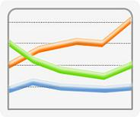
AMR/Highlights: 1Q14 Summary
Full Time Plan
  Deficit continues during 1Q14
      Total Medical expense in 1Q14 was $9.7 million
        $10.4 / $11.3 /9.9/9.6 million in previous four quarters
      Total Rx cost in 1Q14 was $2.4 million
        $2.1 / $2.3/ $2.1 / $2.4 million in previous four quarters
      Overall expense for 1Q14 was $13.1 million
      (4Q13 - $13 million / 3Q13 - $12.9 million)
      1Q14 deficit was $1.8 million
  PPPM Cost 1Q14 - $1,121
  The predominant contribution rate effective January 1, 2014 is $1016.50

Slide 4

AMR/Highlights: 1Q14 Summary
Part Time Plan
  Surplus continues
    1Q14 Surplus - $1.3 million
  Overall expense for 1Q14 was $1.4 million
  (3Q13 - $1.4 million / 4Q13 - $1.3 million)
  PPPM Cost 4Q13 - $38
  The predominant contribution rate effective January 1, 2014 is $71.08

Slide 5

AMR/Highlights: 1Q14 Summary
Special Part Time Plan
  Deficit of $177,500 for 1Q14
  Total expense for 1Q14 was $1.5 million
  (3Q13 - $1.7 million / 4Q13 - $1.4 million)
  PPPM Cost 1Q14 - $307
  The predominant contribution rate effective January 1, 2014 is $291.65

Slide 6

AMR/Highlights: 1Q14 Summary
Combined Plans
  Deficit in Full Time Drove an Overall Deficit for All Combined Plans
      1Q14 deficit - $500,275
  PPPM Cost 1Q14 - $288
  Recap of 1Q14:
    FT – 1Q14 $1.8 million deficit
    PT – 1Q14 $1.2 million surplus
    SPT – 1Q14 $177,500 deficit
    All Plans – 1Q14 $500,275 deficit
    (includes investment and other income)

Slide 7

AMR/Highlights: 1Q14 Summary
Reserve Projection
  As of March 31, 2014 – 1.9 months
        Future projections
          3 months out (6/30/14): 1.7 months
          6 months out (9/30/14): 1.5 months
          12 months out (3/31/15): 1.0 months
  Reserve is based on unassigned reserve only.
  Future projections were based on the prior plan designs, which changed as of March 1, 2014, so projections will be subject to change on subsequent reports.

Slide 8
JAA Status Update
Snapshot
Month | Claims Processed | Billed Amount | Paid Amount
October | 12,541 | 12,550,001 | 4,133,446
November | 10,138 | 8,941,098 | 2,929,027
December | 8,523 | 7,818,525 | 2,430,267
January | 9,606 | 10,865,711 | 3,010,128
February | 8,393 | 9,721,002 | 2,947,214
March | 8,623 | 8,621,078 | 2,555,026
Totals | 57,824 | 58,517,415 | 18,005,108

Slide 9
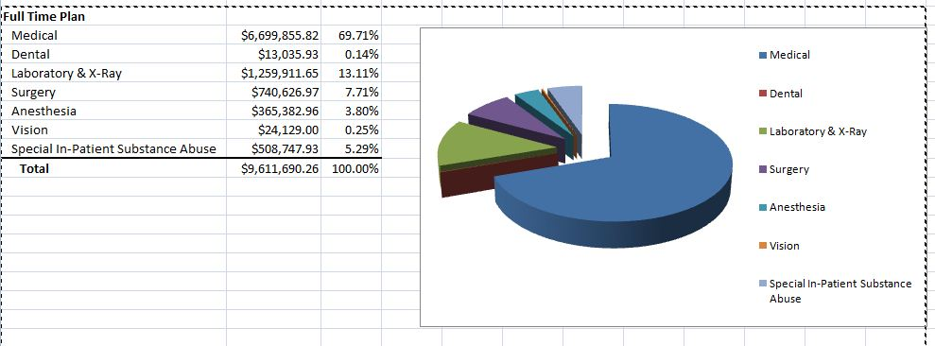
Claims Report - 1Q14

Slide 10
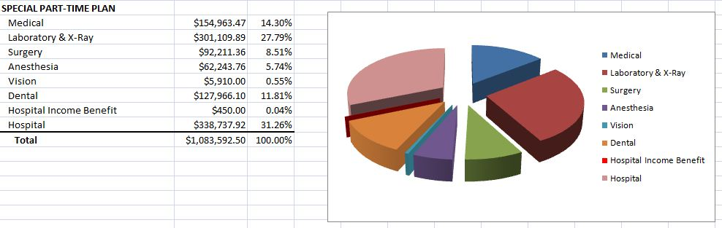
Claims Report – 1Q14, cont’d

Slide 11
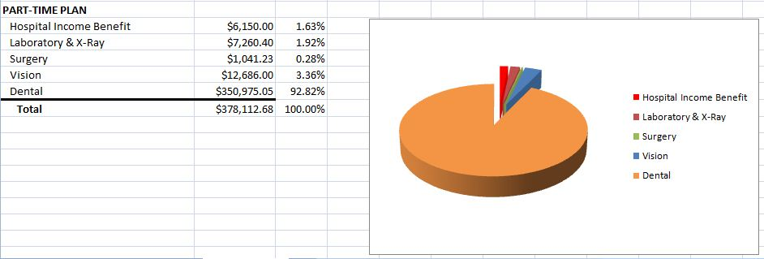
Claims – Report, cont’d

Slide 12
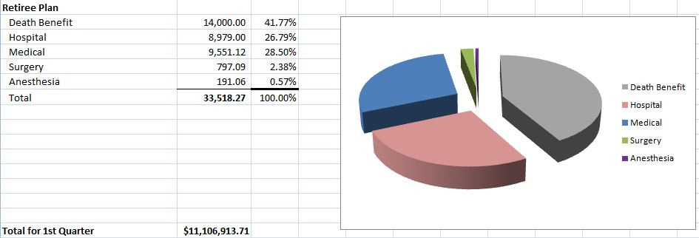
Claims Report 1Q14, cont’d

Slide 13
Appeals
Appeals Subcommittee
  Bruce Both Anthony Speelman
  Richard Grobman Mike Grosso
Tabled Appeals

Slide 14
Other Fund Business
Positive Pay in place
Steep increase in call volume due to benefit changes – additional phone representatives in place
Final mailing to FT spouses to verify other coverage
NETime – online claims access via AA website
  Instructions for access will be posted on the AA website and L1500 website, and will be added to new participant letters
  Phone representatives will alert participants
  An article will be included in the September “Register”
PCORI fee due July 31, 2014
Out-of-network claim discounting option presented

Slide 15
Conclusion
Thank You
Questions?

